Slide 1
INTRODUCTION TO ARDUINO
Phenomena

Slide 2
ABOUT ARDUINO
Arduino is an open-source electronics prototyping platform based on flexible, easy-to-use hardware and software. It is a microcontroller board, contains on-board power supply, USB port to communicate with PC, and an Atmel microcontroller chip. It simplify the process of creating interactive objects or developing environments.
Arduino can sense its environment by receiving inputs from sensors, and interact with its environment by controlling lights, motors, or other actuators. The Arduino integrated development environment (IDE) is open source so you can download and share thousands of interactive projects from internet.

Slide 3
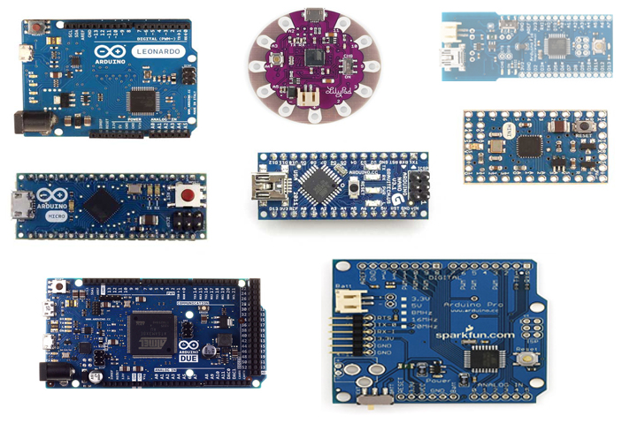
ABOUT ARDUINO

Slide 4
Getting Started
Get Arduino IDE
https://www.arduino.cc/en/Main/Software
What are we doing today?
LED FLASHING PROJECT

Slide 5
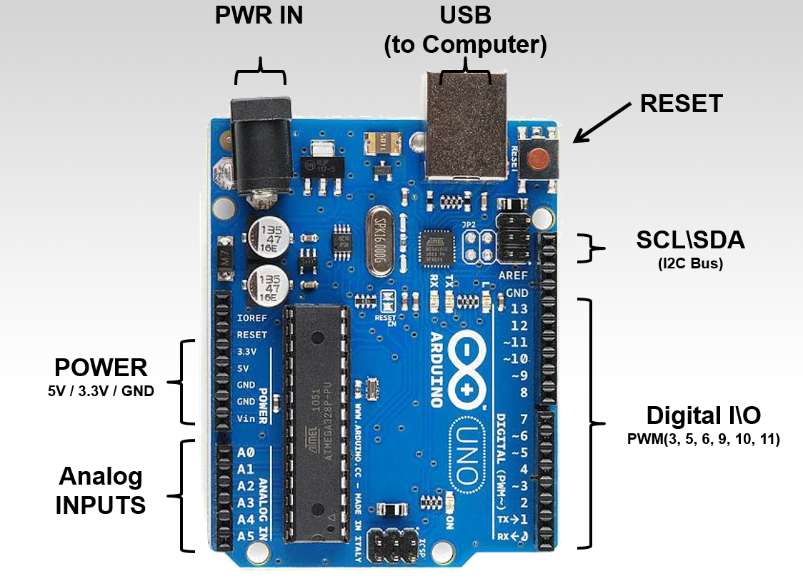
MEET ARDUINO UNO

Slide 6
DIGITAL & ANALOG
Working with electronics means dealing with both analog and digital signals, inputs and outputs. Our electronics projects have to interact with the real, analog world in some way, but most of our microprocessors, computers, and logic units are purely digital components. These two types of signals are like different electronic languages; some electronics components are bi-lingual, others can only understand and speak one of the two.
The common theme among all of these analog signals is their infinite possibilities.
Digital signals and objects deal in the realm of the finite, meaning there is a limited set of values they can be. Anything as long as it’s not ∞.

Slide 7
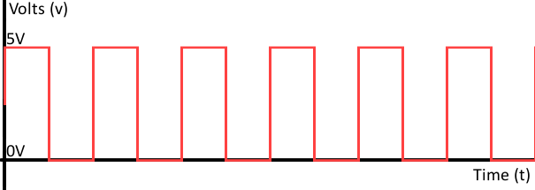
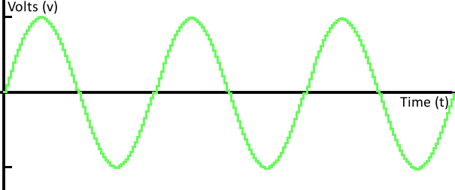
DIGITAL & ANALOG

Slide 8
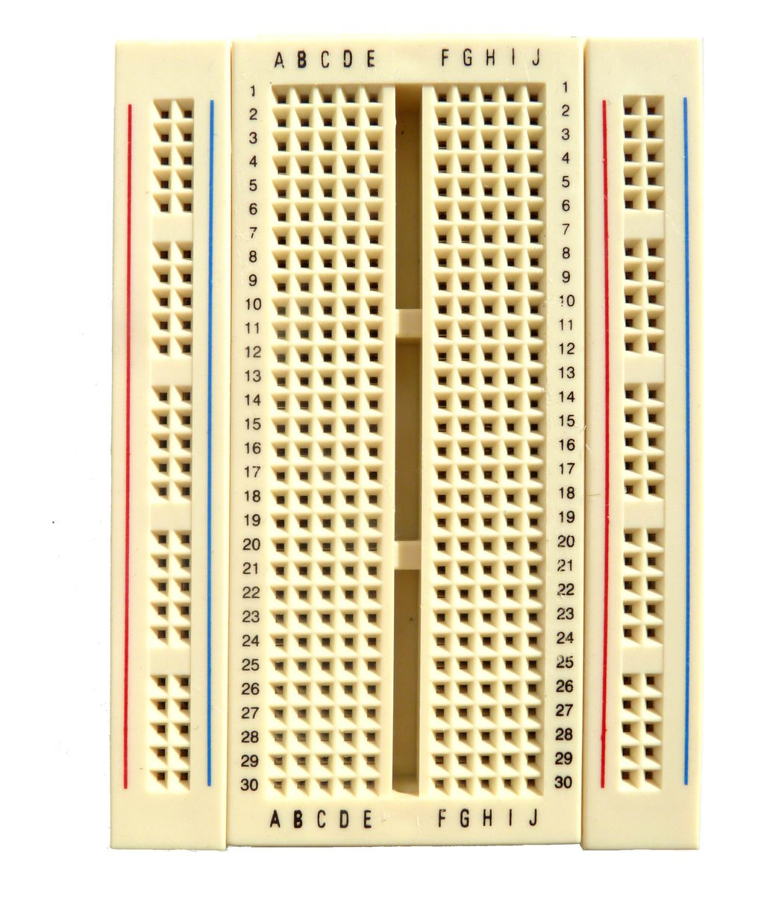
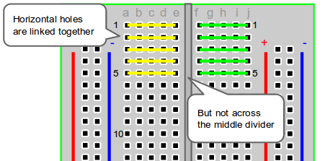
Bread Board

Slide 9
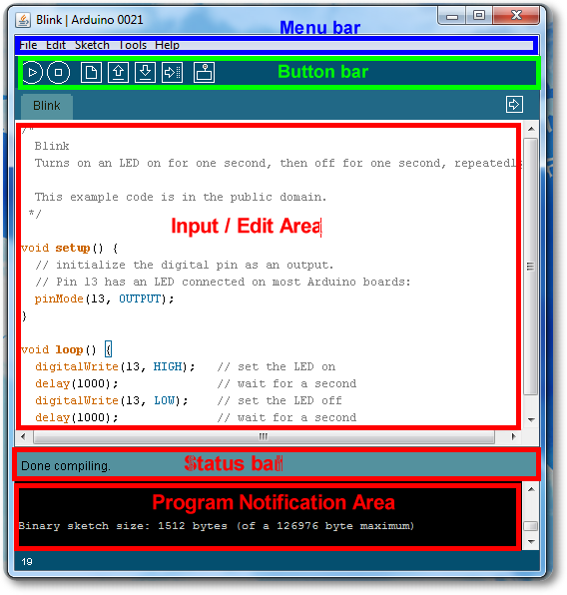
Arduino IDE

Slide 10
Your Turn!
Some music?

